Slide 1
English Stylistics
Week 4 Lexical Features (II)

Slide 2
Review: lexical features I
Word-formation processes
Word types (esp. adjectives)
→ A Room (Babbitt vs. The Handmaid’s Tale)

Slide 3
Word-formation processes
Derivation (or Affixation)
Compounding
Blending and Clipping
Abbreviations, acronyms, initialisms
Neologism (coinage)
Borrowing and calque (loan translation)

Slide 4
Lexical features II
Different types of nouns
Different types of verbs
English words of different origins

Slide 5
Types of nouns
Concrete vs. abstract
General vs. specific (hyponymy 上下义关系)
Lexical set (collocation 词义搭配关系)

Slide 6
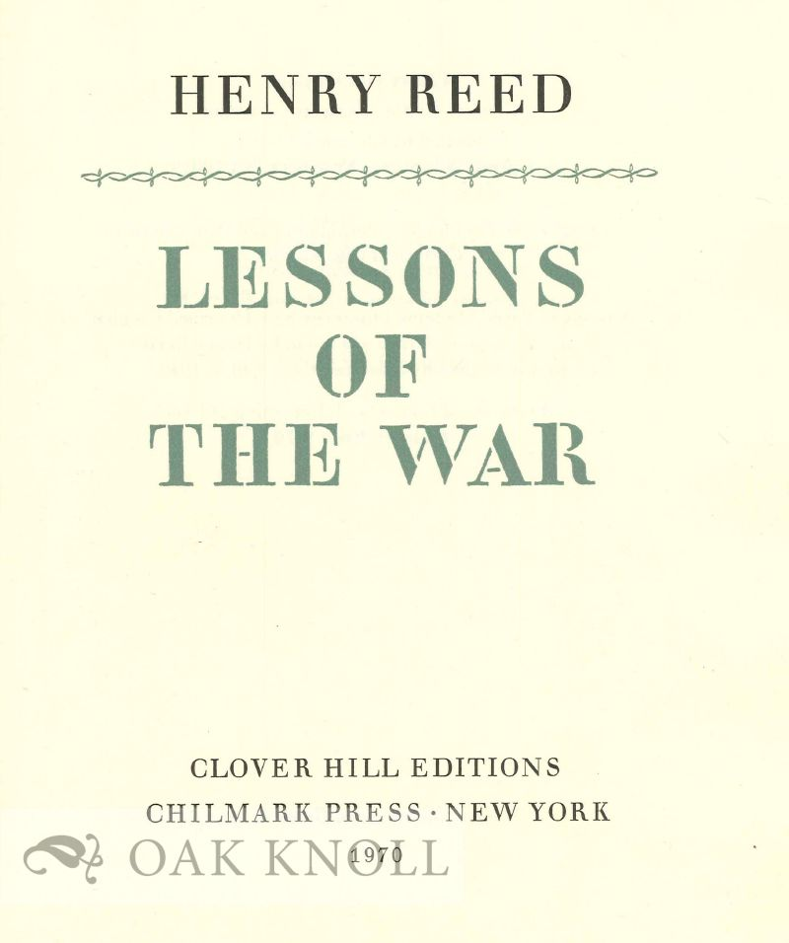
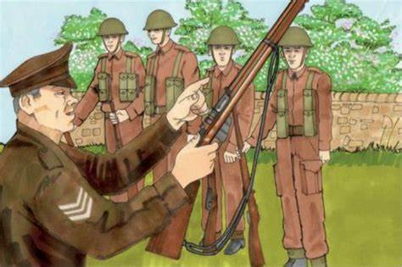
In-class reading: Text 9
“Naming of Parts”, by Henry Reed (1942)

Slide 7
Nouns of different/overlapping sets
Daily cleaning
Naming of parts
Sing swivel
Piling swivel
Safety-catch
Bolt
Spring
Japonica
Coral
Gardens
Branches
Blossom
Bees and flowers
Spring

Slide 8
Henry Reed (1914-1986)
”The contrast between this seemingly prosaic language and the lyrical, meditative voice that also appears in the poem leads to a poignant exploration of the individual experience.”

Slide 9
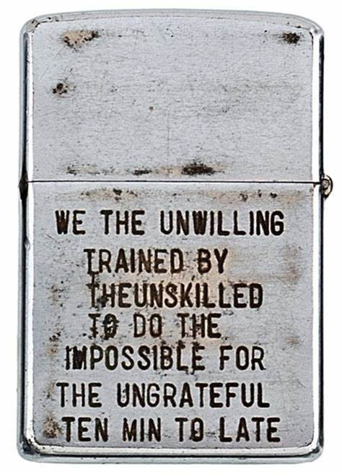
The antiwar sentiment
We the unwilling
Led by the unknowing
To do the impossible
For the ungrateful.

Slide 10
Types of verbs
Notional, auxiliary, model verbs
Action verbs (physical vs. mental)
Active vs. passive voices of verbs
Transitive vs. intransitive verbs
Phrasal verbs

Slide 11

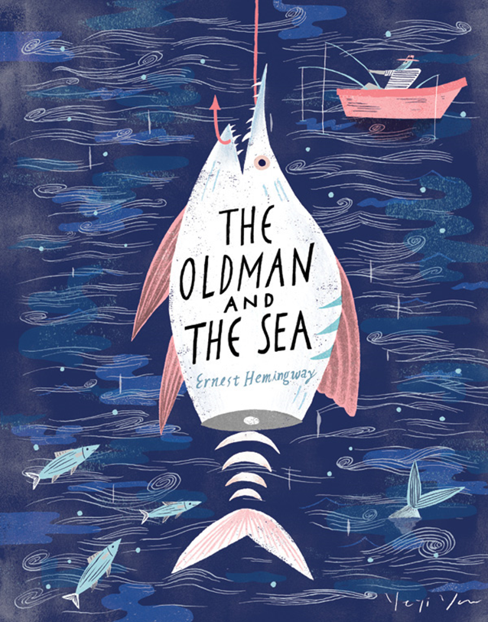
In-class reading: Text 10-11

Slide 12
Action verbs in Text 10
Kick
Swing
Grind
Turn
Scrabble
Heave (himself)
Feel (the wetness)
Spit
Snarl
Glimpse (the trenches)
Force (himself)
Fall
Haul (himself)
Slide
Stumble
Go
Fall

Slide 13
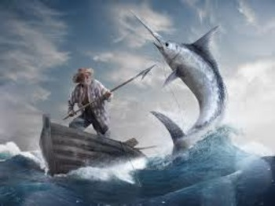
Action verbs in Text 11
See (the shark)
Raise (the club)
Bring (the club)
Slam (the shark)
Feel (the rigidity)
Strike (the shark)

Slide 14
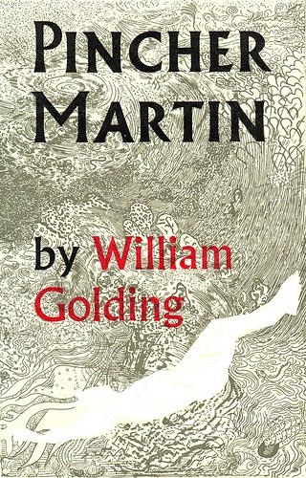
Pincher Martin (1951)
Golding once explains that Martin driven by a selfish greed for life has continued to exist in another dimension: "His drowned body lies rolling in the Atlantic but the ravenous ego invents a rock for him to endure on".

Slide 15
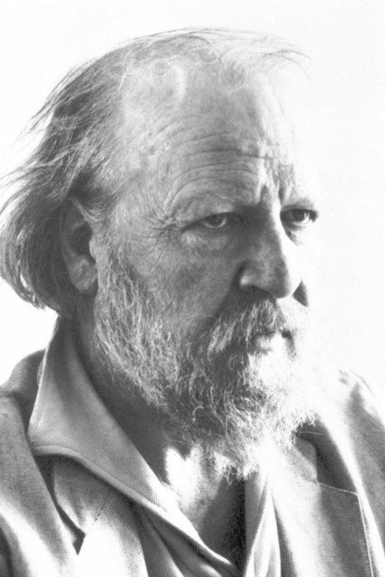
William Golding (1911-1993)
Nobel Prize in Literature 1983
“for his novels which, with the perspicuity of realistic narrative art and the diversity and universality of myth, illuminate the human condition in the world of today.”

Slide 16
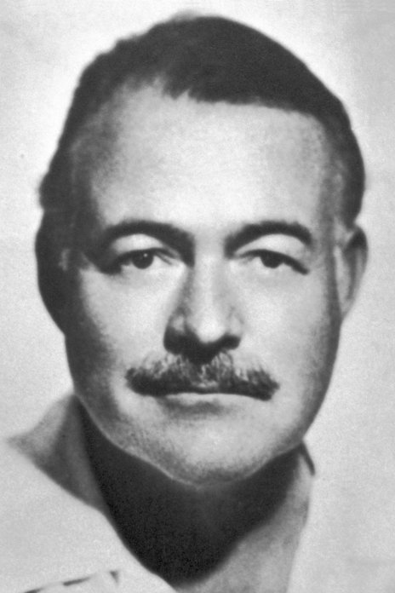
Ernest Miller Hemingway (1899-1961)
The Nobel Prize in Literature 1954
"for his mastery of the art of narrative, most recently demonstrated in The Old Man and the Sea, and for the influence that he has exerted on contemporary style."

Slide 17
English words of different origins: Etymology

Slide 18
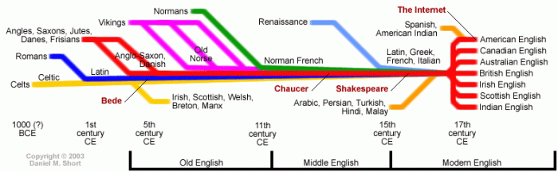
The History of English

Slide 19
Germanic vs. Latinate
bodily = corporal thinking = pensive dog = canine come = arrive
leave = depart
love = affection

Slide 20
Germanic words (Anglo-Saxon)
Basic vocabulary
2 or 3 syllables
Plain, powerful, vivid

Slide 21
Latinate words
multisyllabic, abstract, derivational
Fancy, elegant, urban, educated
Or pretentious

Slide 22
Clipping of the Latinate words
advertisement – ads
influenza – flu
refrigerator – fridge
microphone – mike

Slide 23
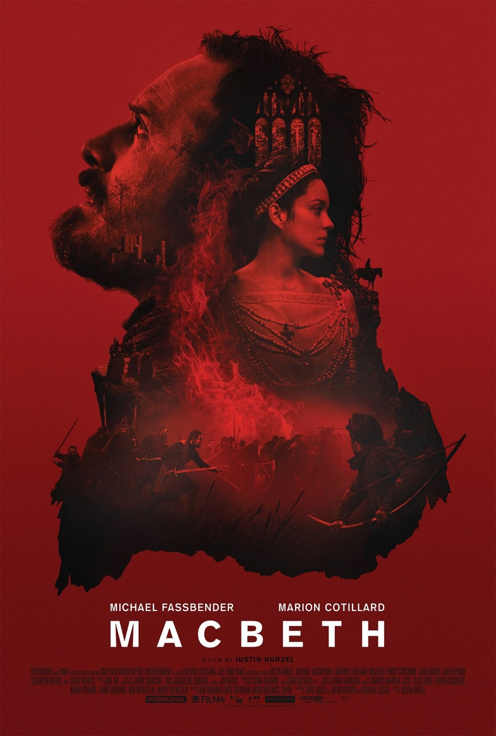
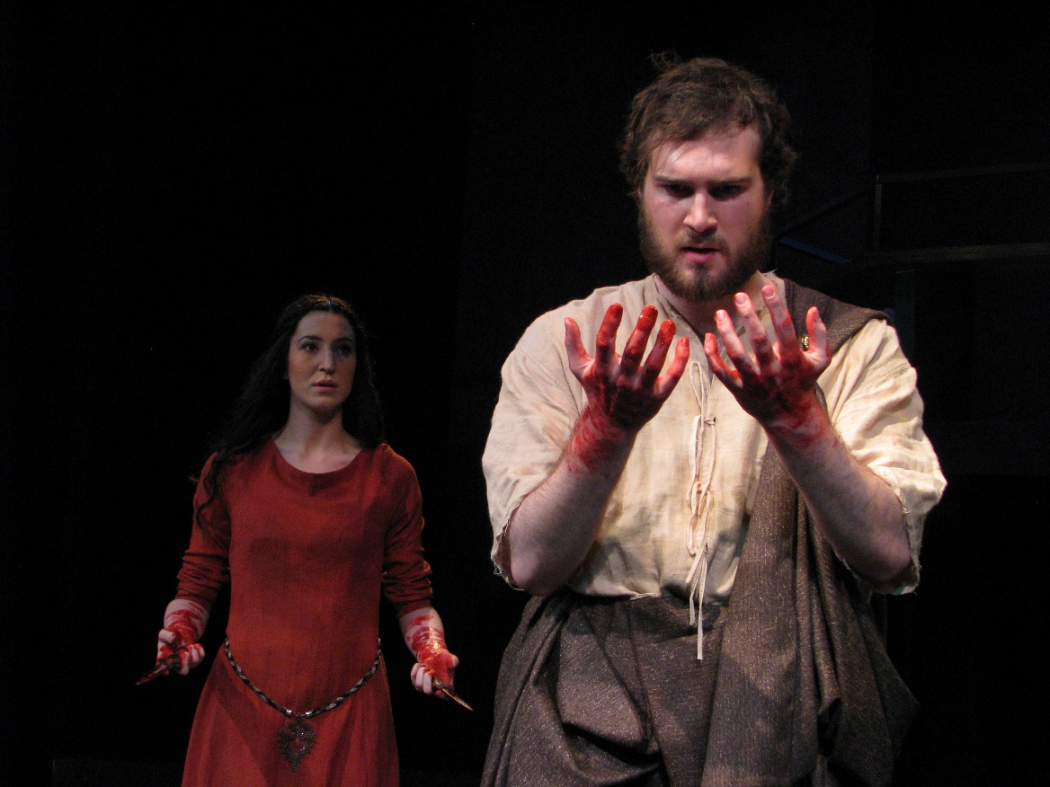
Reading: Text 12
Macbeth (1606)

Slide 24
In-class reading (Text 13-A and 13-B)
Calculate the ratio of Germanic – Latinate words in the two texts, and consider the effect of such lexical choices.
http://etymonline.com/

Slide 25
Formal vs. Less formal correspondence
 | Text A | Text B
Latinate words (total) | 25% (33/133) | 16% (19/122)
Multisyllabic Latinate words | 8% (10/133) | 4% (5/122)

Slide 26
Contrastive tweets
T1 – The GREAT Billy Graham is dead. There was nobody like him! He will be missed by Christians and all religions. A very special man.
T2 – Billy Graham was a humble servant who prayed for so many – and who, with wisdom and grace, gave hope and guidance to generations of Americans.

Slide 27
Contrastive tweets
T1 – Aretha helped define the American experience. In her voice, we could feel our history, all of it and in every shade—our power and our pain, our darkness and our light, our quest for redemption and our hard-won respect. May the Queen of Soul rest in eternal peace.
T2 – The Queen of Soul, Aretha Franklin, is dead. She was a great woman, with a wonderful gift from God, her voice. She will be missed!

Slide 28
Summary: lexical features of style (II)
Nouns of different domains
Different types of verbs
Germanic vs. Latinate words

